Slide 1
CONFIGURATION AUDIT ENGINE
{{ CAE }}
Francisco Poo Hernandez jfrancisco.poo@gmail.com June 2018

Slide 2
AGENDA
Configuration Compliance.
CAE’s Gold Standard | Policy & Runtime Configurations.
CAE’s Conceptual Architecture.
CAE’s Reference & Working Architecture.
CAE’s Enhanced Architecture.
CAE Demo.

Slide 3
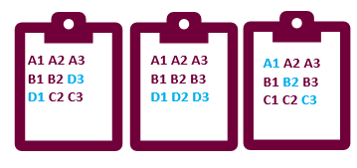
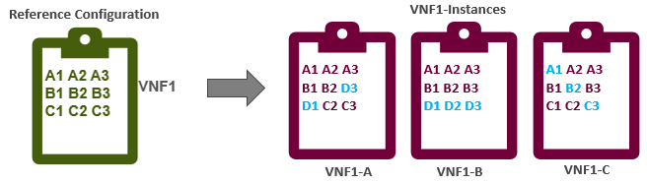
CONFIGURATION COMPLIANCE
VNF1-Instances
1
Configuration Accuracy | Compliance of Network Elements (NE) is a continuous operations challenge.
N
Active Configuration not aligned to reference Configuration.
Notes:
Need to equip Operations teams with means of determining if a given VNF in the environment has been instantiated, scaled out, or updated and remains configured correctly. Simply put a Standardized CM Add-On.
Need a tool, microservices-based providing results in near real-time, portable & platform independent, policy driven and orchestration compliant for enabling closed loop actions and standardized procedures among infrastructure and VNFs.
2017-07-20
1
TMO SCEF Introdcution

Slide 4
What to do ?
Let’s Audit the VNFs configuration periodically to discover unaligned settings.

Slide 5
What do we need?
A "Reference Configuration" we could use as a reference to compare.
The actual VNF's "runtime configuration".

Slide 6



REFERENCE CONFIGURATION
The desired configuration state for any given VNF at the Production Network.
A1 A2 A3
B1 B2 B3
C1 C2 C3
VNF1
Normally kept by different and specific teams or VNF owners.
Different Methodologies and Data formats used among VNFs, e.g. Excel Sheets, Word Docs.
TEAM 1 OPS
X1 Y1 Z1
X2 Y2 Z2
X3 Y3 Z3
VNF2
TEAM 2 OPS + VNF Vendor
Notes:
2017-07-20
1
TMO SCEF Introdcution

Slide 7
How to normalize this data?
A "Data Model", for normalizing Gold Standard Configuration.
An "Audit Policy Definition" to govern audit actions.

Slide 8
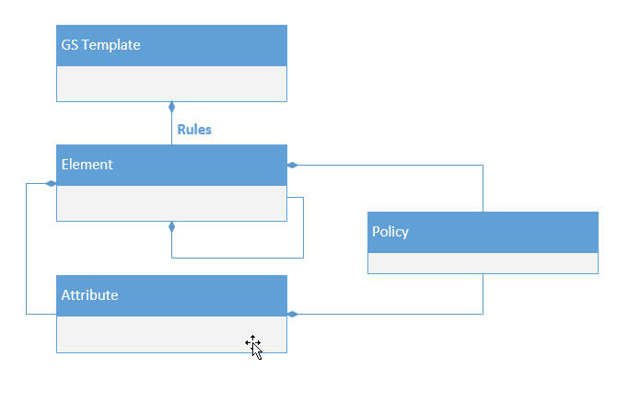
CAE – GOLD STANDARD DATA MODEL
CAE Defines and Implements a “Model Driven VNF Configuration ( based on JSON ) for abstracting VNFs Gold Standard Configurations governed by well defined / established & customizable policies.
VNF1
{
Element: {
“A”: {
“Policy”: {},
“GoldStdVal”: {
“1”,
“2”,
“3”}
}
“B”: {
“Policy”: {policy.general.report-ecm},
“GoldStdVal”: {
“1”,
“2”,
“3”}
}
}
}
A1 A2 A3
B1 B2 B3
C1 C2 C3
VNF1
CAE Gold STD Data Model
VNF1 – CAE JSON
Notes:
2017-05-19
1
Configuration Auditing/CVaaS Scope

Slide 9

CAE - POLICY
A Global JSON based document defining the “IF” “THEN” “ACTIONS” associated to CAE Policies conditions ( NIT, NIC , MOD, OK, FAILED )
Conditions:
NIT (Not In Template) : the tag/variable is not in the template
NIC (Not In Config) : the tag/variable is not in the configuration
MOD (Modification) : for future use
OK : The value of the tag/variable matches the string or regular expression
FAIL : The value of the tag/variable does not match the string or regular expression
Action:
Each “Condition” will have an array of actions / Logic to be executed in serial mode whenever a “Condition” is true. This will facilitate future closed loop actions.
{
"Identification": "VNF Policy",
"Version":"1.0",
"Updatedate":"2017-10-25",
"SupportedVnf": [ “VNF1", “VNF2” ],
"policy" : {
"general":{
"report-ecm" : {
"Type" : "Node",
"conditions" : {
"NIT": [ "" ],
"NIC": [ "do-something"],
"MOD": [],
"OK": [ “" ],
"FAIL": [ “ALARM", “ECM”]
}
}
}
Notes:
2017-05-19
1
Configuration Auditing/CVaaS Scope

Slide 10
What about VNF Runtime Configuration?

Slide 11




VNF NATIVE CONFIGURATION
The runtime or active configuration at any given VNF in the Production Network.
cli A A1 A2
cli B B1 B2
cli C C1 C2
Although there are configuration standards many VNFs provide their runtime configuration print out in different formats e.g. XML, CLI Format in TXT file, JSON, etc.
VNF 1
TXT
<X>
<X1> <X2>
</X>
<Y>
<Y1> <Y2>
</Y>
VNF 2
XML
Notes:
2017-07-20
1
TMO SCEF Introdcution

Slide 12
How to process multiple formats?
Leverage CAE Plug-Ins...

Slide 13
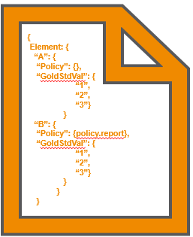

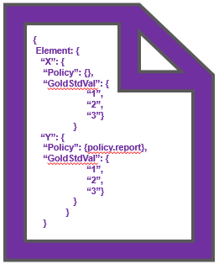

CAE - PLUGIN
Plug-In Modules are created for translating the native runtime VNF Configuration into a VNF CAE auditable JSON Format that the CAE Engine is able to process.
cli A A1 A2
cli B B1 B2
cli C C1 C2
VNF 1
CAE Plug-In for VNF 1
TXT
<X>
<X1> <X2>
</X>
<Y>
<Y1> <Y2>
</Y>
VNF 2
CAE Plug-In for VNF 2
XML
Notes:
2017-05-19
<number>
Configuration Auditing/CVaaS Scope

Slide 14


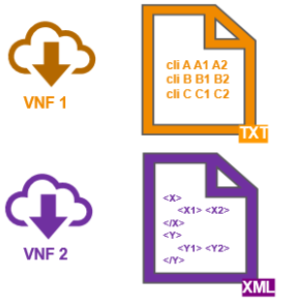


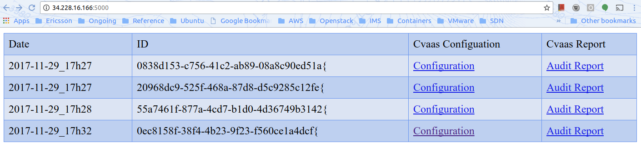
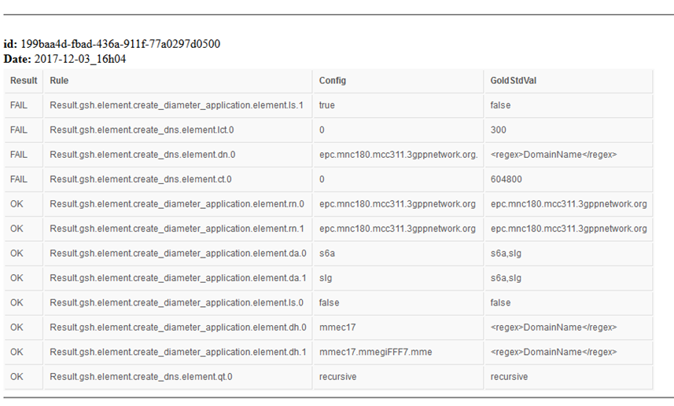
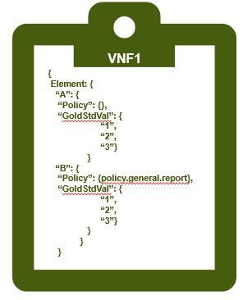
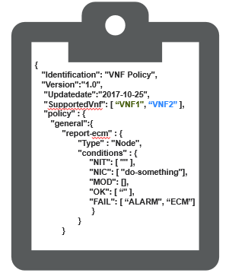

CAE – CONCEPTUAL ARCHITECTURE
Array of Closed Loop Actions
2
2
4
1
4
3
CAE Engine
Audit Reports
CAE Gold STD | Policy for VNF1 & 2
Notes:
How to collect and streamline VNF Configurations.
Version Control of the Gold Std and Policy Data.
Scale CAE out.
Extend accessibility and integration to Third Systems.
2017-05-19
<number>
Configuration Auditing/CVaaS Scope

Slide 15
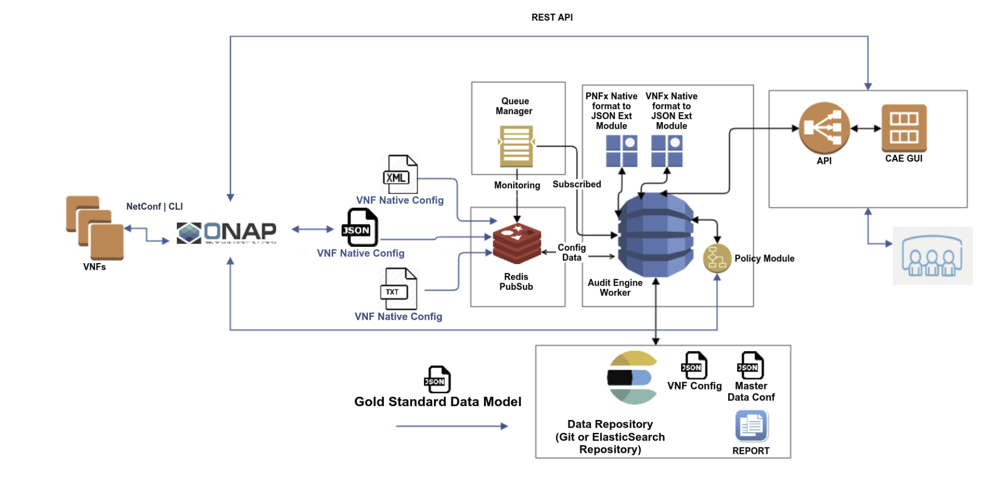
{{ CAE }} REFERENCE ARCHITECTURE.

Slide 16
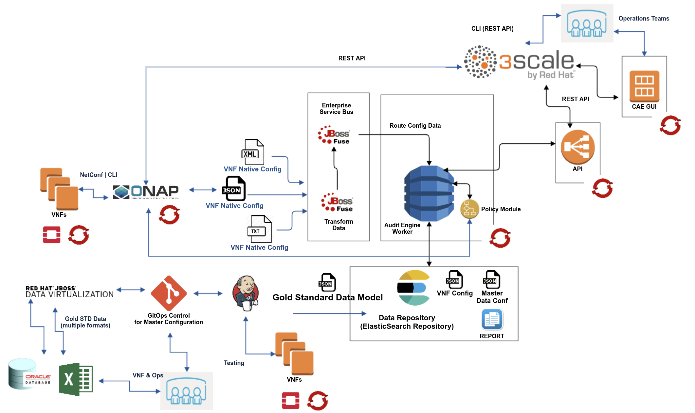
{{ CAE }} ARCHITECTURE
ENHANCED

Slide 17
CAE DEMO
Perform vMME Audit with CAE :
Review vMME Native Configuration.
Review vMME Gold Standard & Generic Policy (JSON).
Review Containerized Deployment | Scale Out.
Feed vMME configuration to CAE.
Review Audit Results.

Slide 18
THANK YOU.
https://github.com/moffzilla/CAE

Slide 19
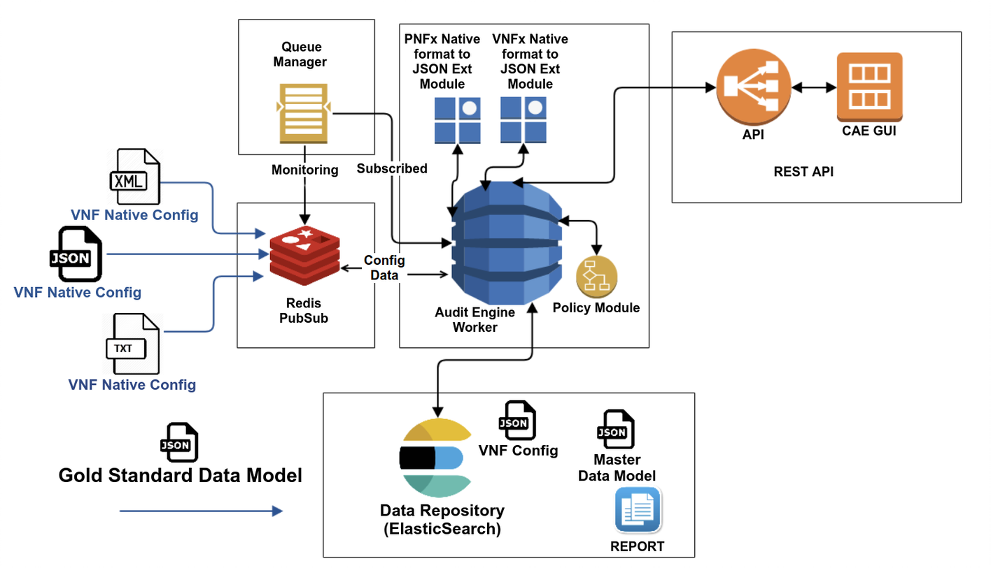

Slide 20
SOLUTION: CLOUD AUDIT ENGINE (CAE)
VNF Configuration Auditing engine by Ericsson
Microservices architecture , with containers components and scalable for production workloads.
VNF-Agnostic Gold Standard Data Model (JSON) & Native Configuration Extension Module (tested w/ vMME).
Policy Driven with ECM closed loop operations “hooks”.
Capable of supporting VNF / PNF and OpenStack components ( Extension Module development required).
Integration to ECM for driving Audit Jobs with workflows and providing NFV runtime configurations.
GitOps model for Gold Standard Data Model management.
Engine Currently used for a major carrier for vMME , Load Balancer and OpenStack Validation (End to End Configuration Compliance Stack)
CAE High level Architecture
CAE supports increased operational efficiency by providing an automated & standard way of auditing VNF configurations.
Notes:
CAE supports increased operational efficiency by providing an automated, standard way of auditing VNF configuration
Version Control
Management of changes to Ansible Playbooks, HOT Templates Scripts, Site information documents, and any other associated artifact by recording changes to all set of files over time so specific versions later could be re-used for specific sites and evolve with time.
2017-12-19
<number>

Slide 21
